Slide 1
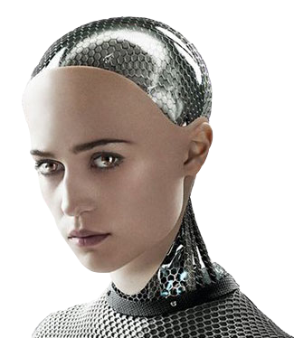
Introductions
Ayodamola Ajibola
Khawla El Msalti
Jia Ren Goh
Alex Moreton

Slide 2

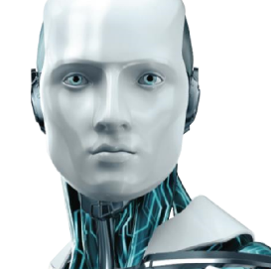
A.V.A
The Development of a Chatbot
Module: Project Management
Tutor: Andreas Oikonomou
Notes:
To use this title animation slide with a new image simply 1) move the top semi-transparent shape to the side, 2) delete placeholder image, 3) click on the picture icon to add a new picture, 4) Move semi-transparent shape back to original position, 5) Update text on slide.

Slide 3
Applications
01.
Ease of handling multiple customers
02.
Constant availability
03.
Acting as a personal assistant
04.
Dealing with standard queries

Slide 4
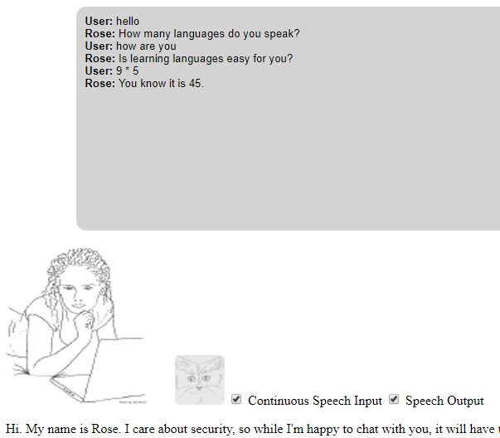
Other existing chatbots
Rose
Text recognition
Speech recognition
Avatar
Inputs and outputs with text or voice

Slide 5
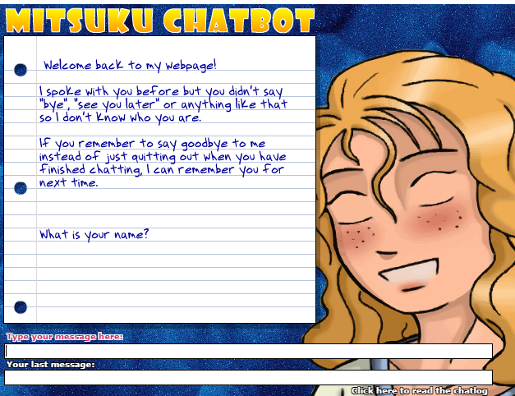
Other existing chatbots
Mitsuku
01.
Text recognition
02.
Avatar
03.
Learns from users
04.
Speaks three languages

Slide 6
Ava’s features
Text recognition
Choice of avatar and voice
Can perform searches, tell time and complete calculations
Implements learner class
Cross-platform compatibility
Website with downloads

Slide 7
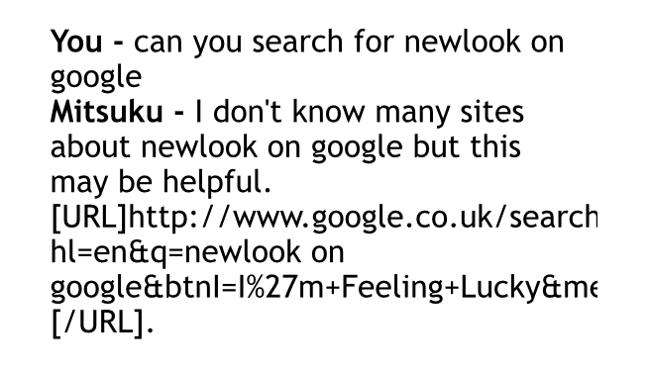
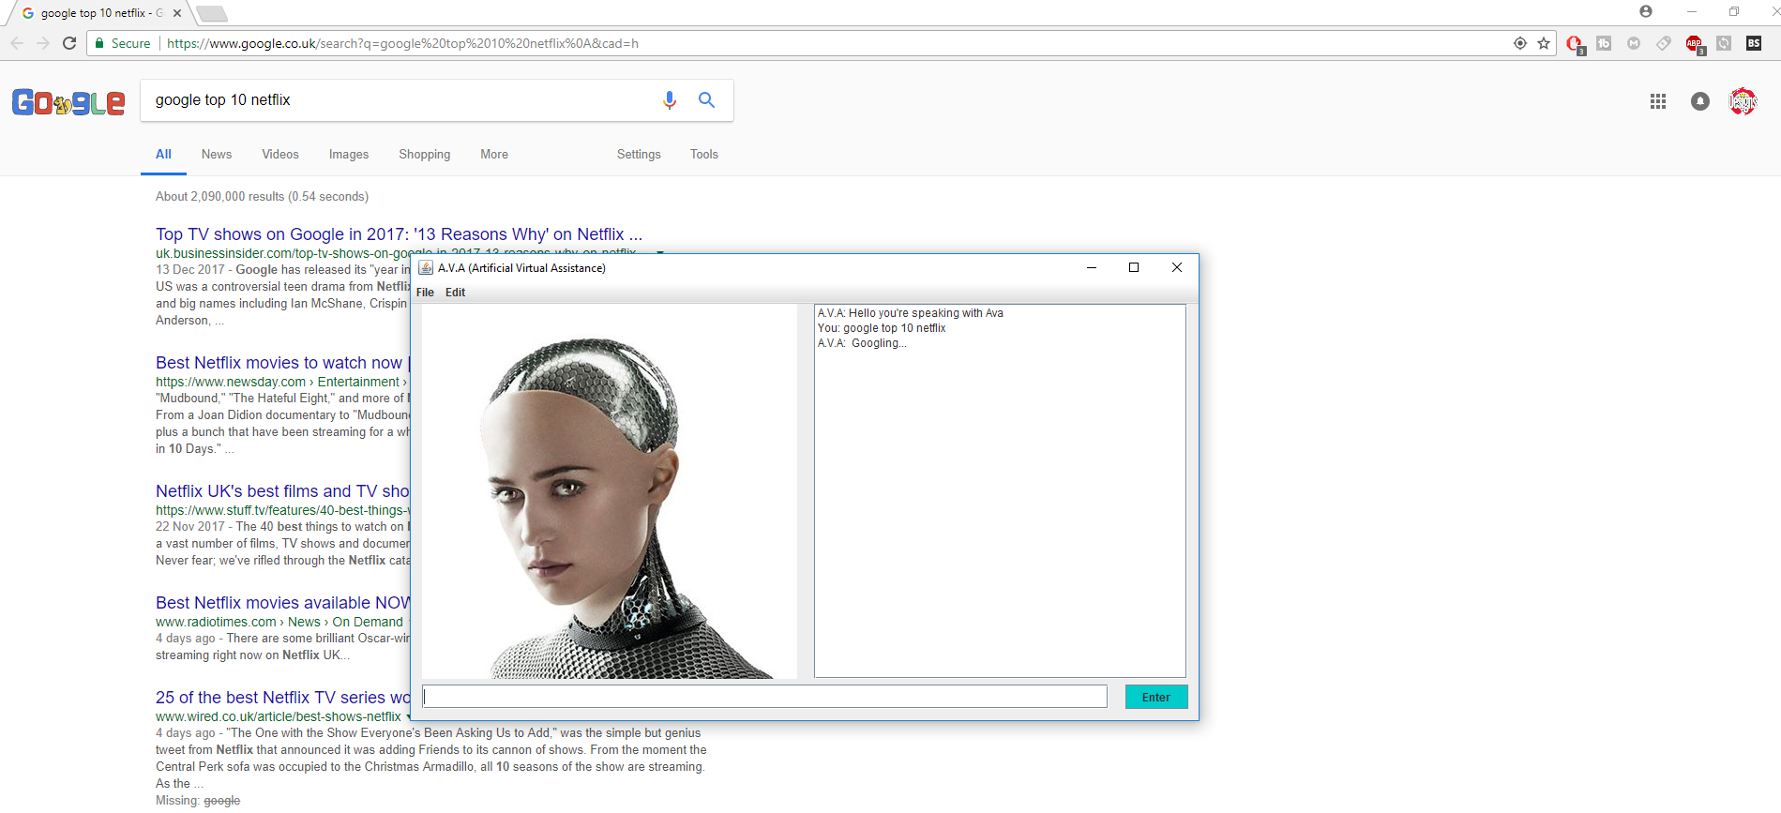
Comparisons
Mitsuku google searching
Ava google searching

Slide 8
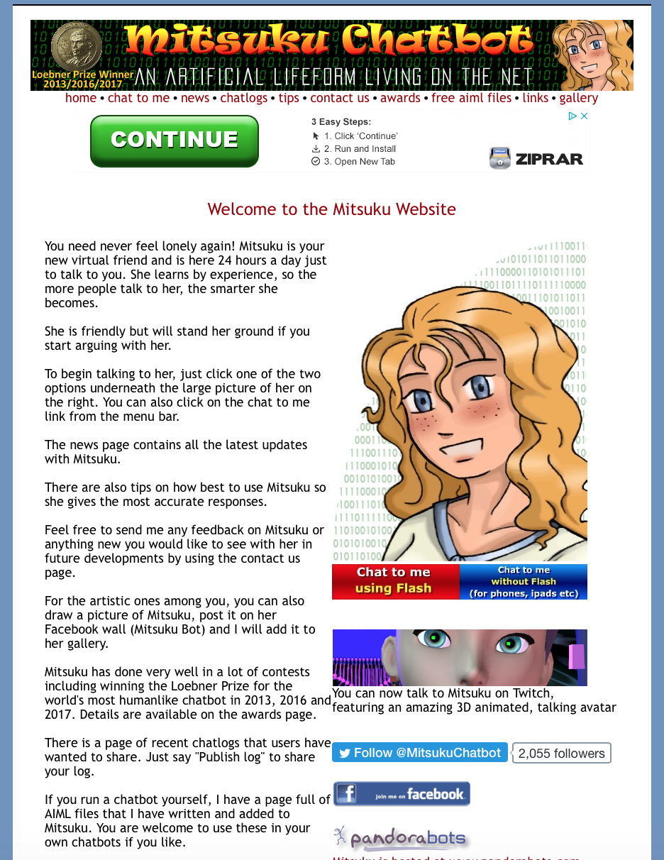
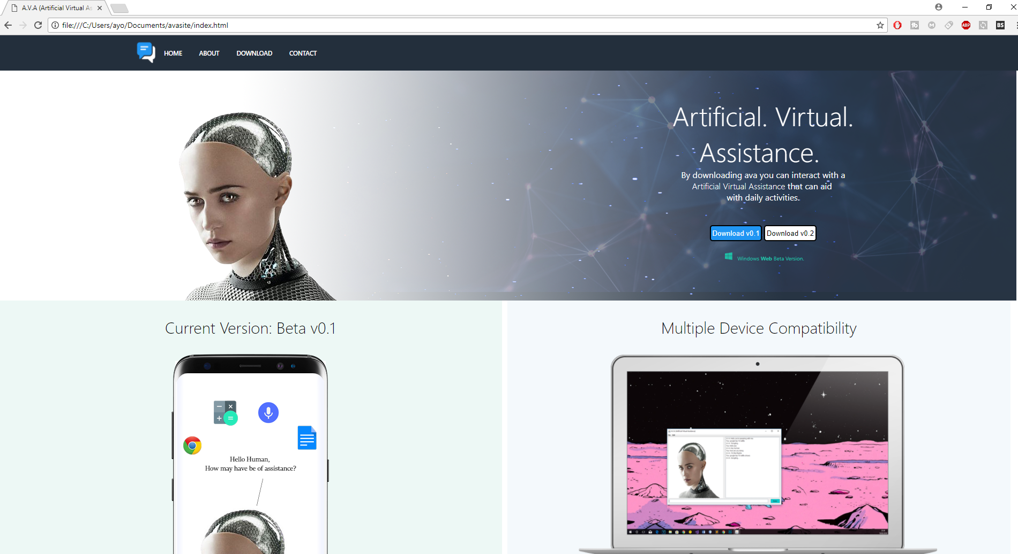
Comparisons
Mitsuku’s website
Ava’s website

Slide 9
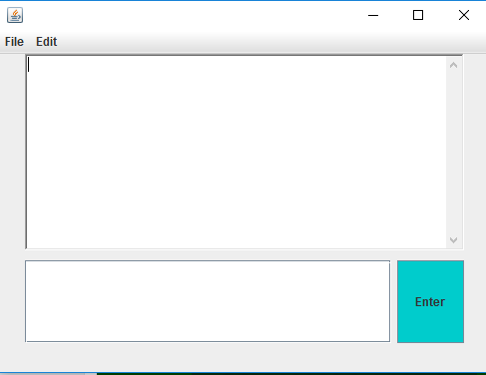
Original prototype
01.
Pre-programmed
responses to specific
messages
02.
Basic GUI
03.
No machine learning
04.
Lack of text to speech
functionality

Slide 10
Development
Followed an Agile project management system
Used the Belbin test to find each member’s strengths and place in the team
Held regular meetings to ensure that members were on track and to exchange ideas on project development

Slide 11
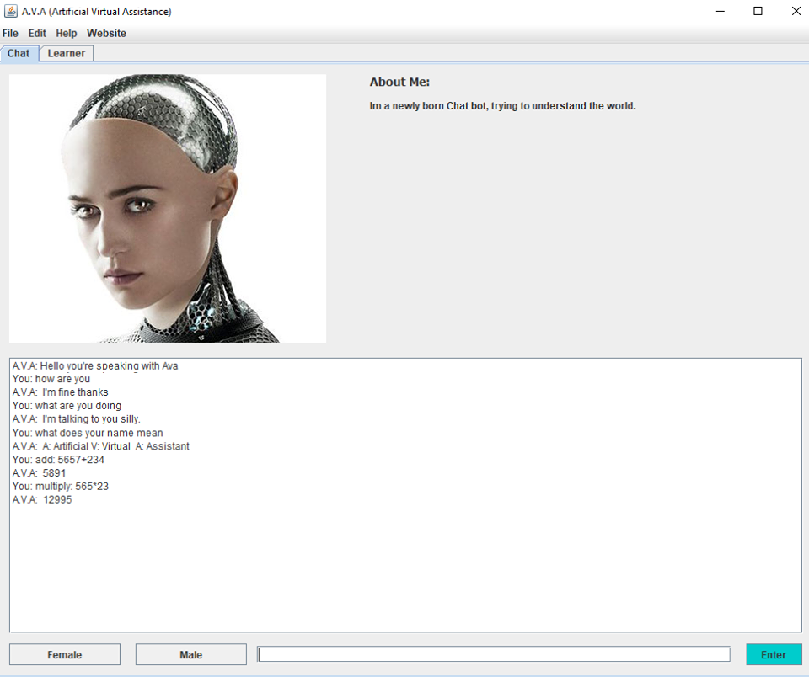
Completed product
01.
Full GUI with variable voice
and avatar
02.
Responses based on keyword
detection
03.
Capable of calculations, telling
Time and accessing internet
04.
Implemented learner class

Slide 12
Future aspirations
Further integration into other programs, allowing for accessing different applications
Profile creation, allowing for users to be ‘remembered’
Learner class more closely integrated with main functions

Slide 13
Thank you for your time
Any questions?

